Slide 1
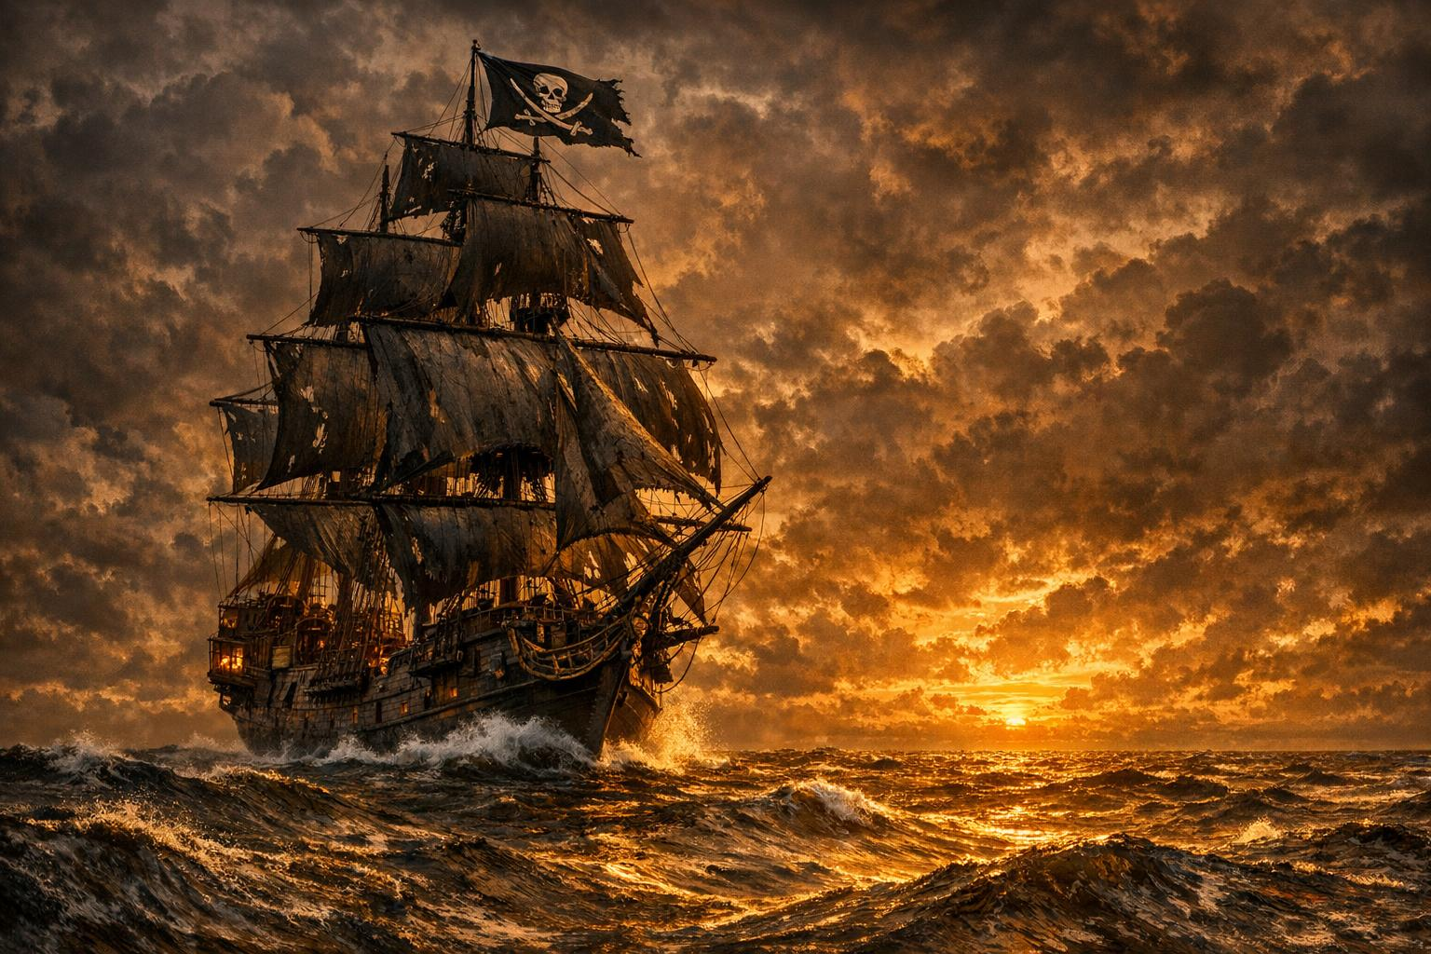
AHOY!
Pirate Dinner Night
Dress Like a Pirate. Talk Like a Pirate. Feast Like a Pirate
PICK A DATE
June 22, July 1, July 8, July 13
$60 Per Person – 4 Course Meal with paired drinks.
An Unforgettable Evening of Plunder & Provisions

Slide 2
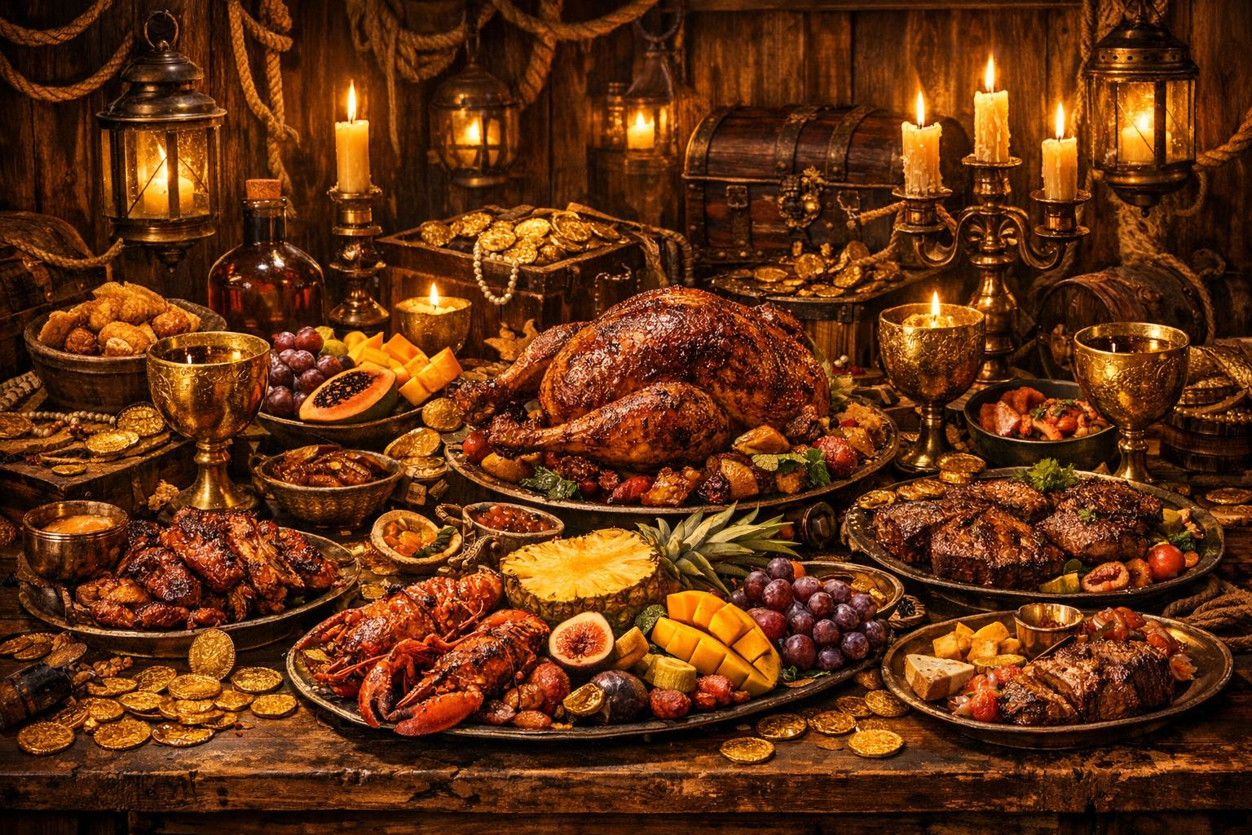
The Captain's Feast
jt
Second
Cannonball Meatballs
Chocolate Dubloons
Plantains
Espresso Martini
Caribbean Style Soup
Rustic Bread with spread
Dark Rum
Third
Plundered Sweets
Steak With Rum Sauce
Fire Grilled Pineapple
Shipwreck Dirty Rice
Spiced Ale / Spicy Stormy
Dark Rum Cake
Rum With Coconut Cream

Slide 3

The Pirate's Code
Dress the Part
Ye can arrive in full pirate regalia — tricorn hats, eye patches, and buckled boots be encouraged!
Talk Like a Pirate
No landlubber tongue! Every word be spoken in proper pirate parlance, savvy?
No Quarter for Phones
Stow yer devices! This be a night for merry-makin', not screen-gazin'.
Share the Bounty
Pass the grog and mingle with ye shipmates, ye salty dog!

Slide 4
SET SAIL!
When
Pick a date – June 22, July 1, July 8, July 13 (6:30)
Where
Loaded Cannon Distillery
Cost
60 Doubloons Per Scallywag (includes feast & grog)
RSVP
Send word by carrier parrot before June 14
Arrr... Ye Don't Want to Miss This, Matey!

